Slide 1
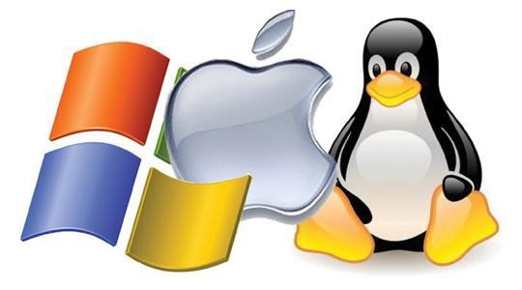
CS-3103 : Operating Systems : Sec-A (NB) : Introduction

Slide 2
Chapter 1: Introduction
What is an Operating System?
Computer-System Organization
Operating-System Structure
Operating-System Operations
Process Management
Memory Management
Storage Management
Protection and Security

Slide 3


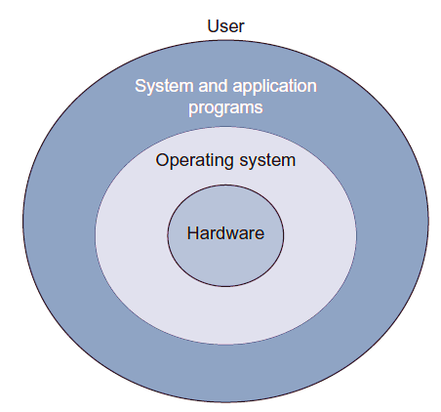
What is an OS with us every day (may be 24/7) ?
When a computer is turned on, the operating system (OS) is loaded into its main memory and it takes control of the system.
It provides an interface to the user for interaction.
Set of programs that acts as an interface between the user and the machine.
It manages and allocates the resources available in the computer system, thus, OS can be considered as a resource manager.
Examples: Windows, Mac OS,
Unix,Linux, etc.
CSEN3103-BTech-Sec A

Slide 4
Computer System Structure
Computer system can be divided into four components:
  Hardware – provides basic computing resources
    CPU, memory, I/O devices
  Operating system
    Controls and coordinates use of hardware among various applications and users
  Application programs – define the ways in which the system resources are used to solve the computing problems of the users
    Word processors, compilers, web browsers, database systems, video games
  Users
    People, machines, other computers

Slide 5
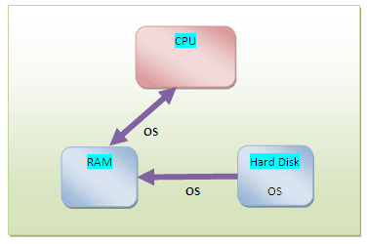
Objectives of an Operating System?
User-friendly
Interprets commands
Creates an environment for other programs to execute on the CPU
Allocates resources to the executing program as and when required
Harnesses the full power of the machine
CSEN3103-BTech-Sec A

Slide 6

Four Components of a Computer System

Slide 7
User View
The user's view of the computer varies according to the interface being used
Single user computers (e.g., PC, workstations). Such systems are designed for one user to monopolize its resources. The goal is to maximize the work (or play) that the user is performing. the operating system is designed mostly for ease of use and good performance.
Multi user computers (e.g., mainframes, computing servers). These users share resources and may exchange information. The operating system in such cases is designed to maximize resource utilization -- to assure that all available CPU time, memory, and I/O are used efficiently and that no individual users takes more than their air share.

Slide 8
User View (Cont.)
Handheld computers (e.g., smartphones and tablets). The user interface for mobile computers generally features a touch screen. The systems are resource poor, optimized for usability and battery life.
Embedded computers (e.g., computers in home devices and automobiles) The user interface may have numeric keypads and may turn indicator lights on or off to show status. The operating systems are designed primarily to run without user intervention.

Slide 9
System View
From the computer's point of view, the operating system is the program most intimately involved with the hardware. There are two different views:
The operating system is a resource allocator
  Manages all resources
  Decides between conflicting requests for efficient and fair resource use
The operating systems is a control program
  Controls execution of programs to prevent errors and improper use of the computer

Slide 10
Let’s learn some more keywords regarding Operating Systems
A more common definition, and the one that we usually follow, is that the operating system is the one program running at all times on the computer -- usually called the kernel.
Along with the kernel, there are two other types of programs:
  System programs, which are associated with the operating system but are not necessarily part of the kernel.
  Application programs, which include all programs not associated with the operation of the system.

Slide 11
Let’s learn some more keywords regarding Operating Systems
The emergence of mobile devices, have resulted in an increase in the number of features that constituting the operating system.
Mobile operating systems often include not only a core kernel but also middleware -- a set of software frameworks that provide additional services to application developers.
For example, each of the two most prominent mobile operating systems -- Apple's iOS and Google's Android -- feature a core kernel along with middleware that supports databases, multimedia, and graphics (to name only a few).

Slide 12
Evolution of Computer Systems
Users
Applications
Database System
Operating System
Hardware

Slide 13
Computer-System Organization
A modern general-purpose computer system consists of one or more CPUs and a number of device controllers connected through a common bus that provides access to shared memory.
Each device controller is in charge of a specific type of device (for example, disk drives, audio devices, or video displays). Each device controller has a local buffer.
CPU moves data from/to main memory to/from local buffers.
The CPU and the device controllers can execute in parallel, competing for memory cycles. To ensure orderly access to the shared memory, a memory controller synchronizes access to the memory.

Slide 14

Modern Computer System

Slide 15
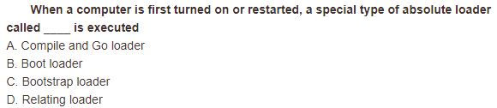
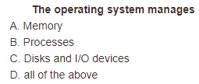
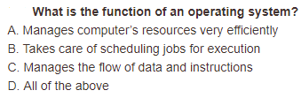
Let’s relax a bit….
1.
1. c), 2. d), 3. d)
2.
3.

Slide 16
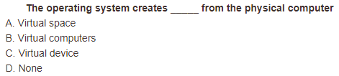
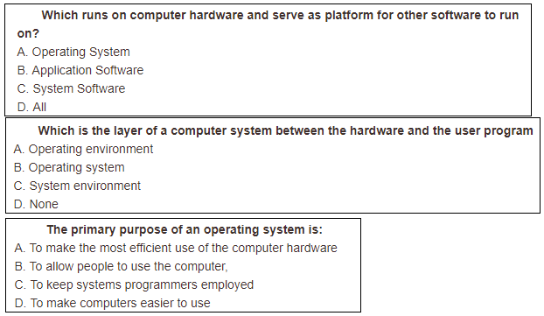
Let’s relax a bit….
1.
2.
3.
1. a), 2. a), 3. b), 4. a)
4.

Slide 17
Computer Startup
Bootstrap program is loaded at power-up or reboot
  Typically stored in ROM or EPROM, generally known as firmware
  Initializes all aspects of system
  Loads operating system kernel and starts execution

Slide 18
Computer-System Operation
Once the kernel is loaded and executing, it can start providing services to the system and its users.
Some services are provided outside of the kernel, by system programs that are loaded into memory at boot time to become system processes, or system daemons that run the entire time the kernel is running.
On UNIX, the first system process is init and it starts many other daemons. Once this phase is complete, the system is fully booted, and the system waits for some event to occur.
The occurrence of an event is usually signaled by an interrupt.

Slide 19
Interrupts
There are two types of interrupts:
  Hardware -- a device may trigger an interrupt by sending a signal to the CPU, usually by way of the system bus.
  Software -- a program may trigger an interrupt by executing a special operation called a system call.
A software-generated interrupt (sometimes called trap or exception) is caused either by an error (e.g., divide by zero) or a user request (e.g., an I/O request).
An operating system is interrupt driven.

Slide 20
Common Functions of Interrupts
When an interrupt occurs, the operating system preserves the state of the CPU by storing the registers and the program counter
Determines which type of interrupt has occurred and transfers control to the interrupt-service routine.
An interrupt-service routine is a collection of routines (modules), each of which is responsible for handling one particular interrupt (e.g., from a printer, from a disk)
The transfer is generally through the interrupt vector, which contains the addresses of all the service routines
Interrupt architecture must save the address of the interrupted instruction.

Slide 21
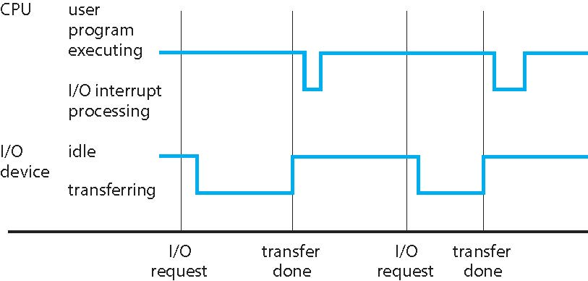
Interrupt Timeline

Slide 22
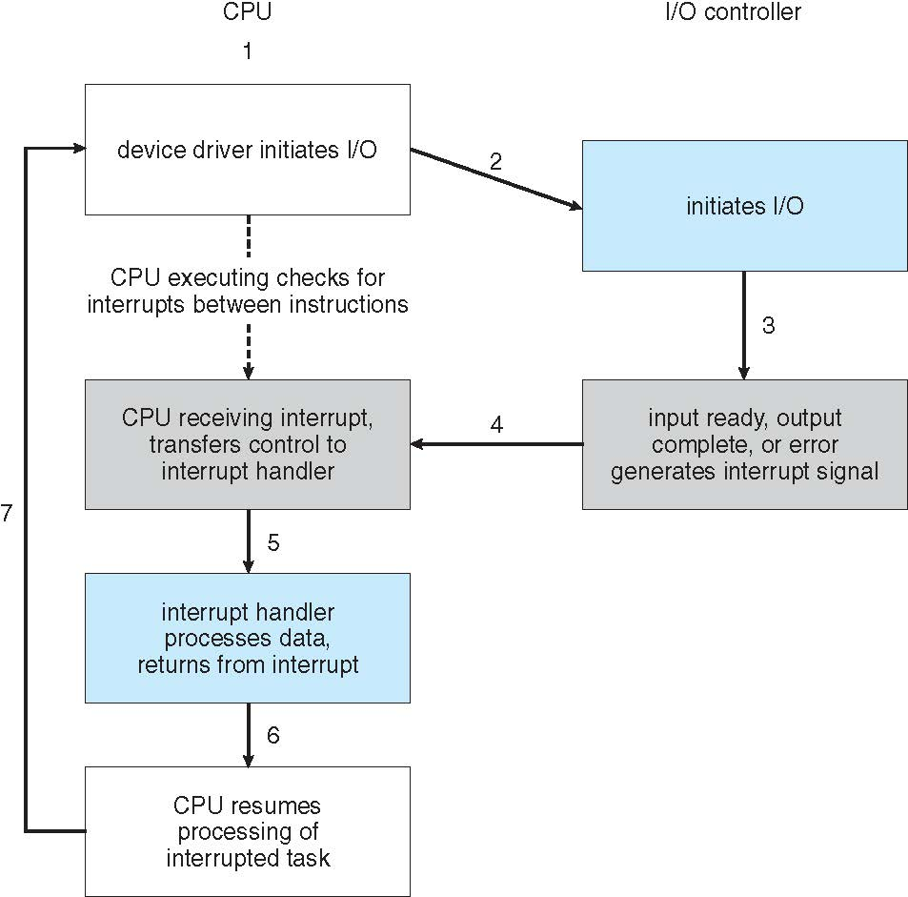
Interrupt-driven I/O cycle.

Slide 23
Storage Definition
The basic unit of computer storage is the bit. A bit can contain one of two values, 0 and 1. All storage in a computer is based on collections of bits.
A byte is 8 bits, and on most computers it is the smallest convenient chunk of storage.
A less common term is word, which is a given computer architecture’s native unit of data. A word is made up of one or more bytes.

Slide 24
Storage Definition (Cont.)
Computer storage, along with most computer throughput, is generally measured and manipulated in bytes and collections of bytes.
  A kilobyte, or KB, is 1,024 bytes
  a megabyte, or MB, is 1,024² bytes
  a gigabyte, or GB, is 1,024³ bytes
  a terabyte, or TB, is 1,024⁴ bytes
  a petabyte, or PB, is 1,024⁵ bytes
  exabyte, zettabyte, yottabyte
Computer manufacturers often round off these numbers and say that a megabyte is 1 million bytes and a gigabyte is 1 billion bytes. Networking measurements are an exception to this general rule; they are given in bits (because networks move data a bit at a time).

Slide 25
Storage Hierarchy
Storage systems organized in hierarchy
  Speed
  Cost
  Volatility
Caching – copying information from “slow” storage into faster storage system;
  Main memory can be viewed as a cache for secondary storage
Device Driver for each device controller to manage I/O
  Provides uniform interface between controller and kernel

Slide 26
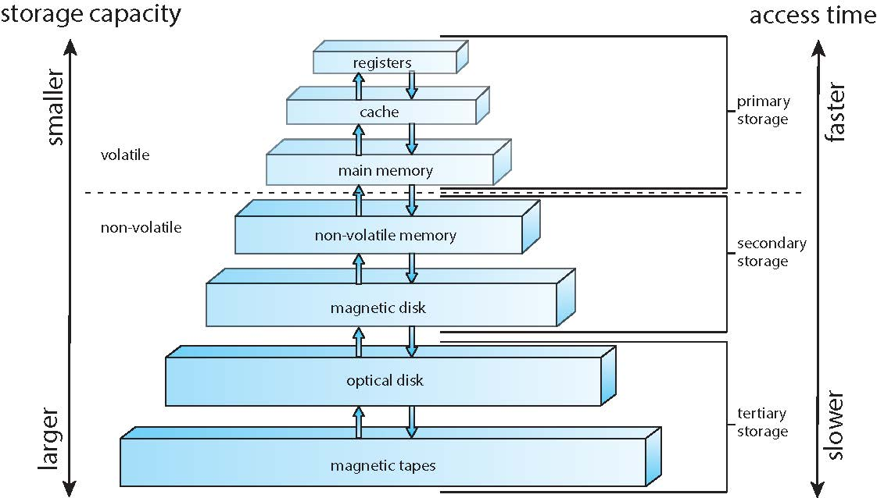
Storage-device hierarchy

Slide 27
Computer-System Architecture
Single general-purpose processor
  Most systems have special-purpose processors as well
Multiprocessors systems
  Also known as parallel systems, tightly-coupled systems
  Advantages include:
    Increased throughput
    Economy of scale
    Increased reliability – graceful-degradation/fault-tolerance
  Two types:
    Symmetric Multiprocessing – each processor performs all tasks
    Asymmetric Multiprocessing – each processor is assigned a specific task.

Slide 28
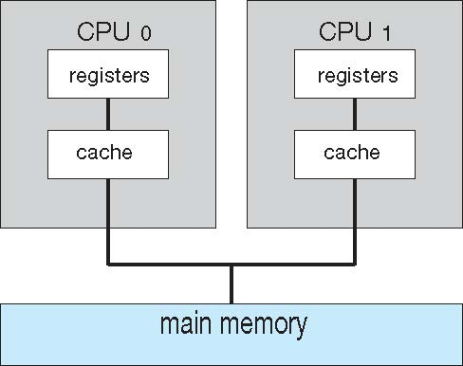
Symmetric Multiprocessing Architecture

Slide 29
Multicore Systems
Most CPU design now includes multiple computing cores on a single chip. Such multiprocessor systems are termed multicore.
Multicore systems can be more efficient than multiple chips with single cores because:
  On-chip communication is faster than between-chip communication.
  One chip with multiple cores uses significantly less power than multiple single-core chips, an important issue for laptops as well as mobile devices.
Note -- while multicore systems are multiprocessor systems, not all multiprocessor systems are multicore.

Slide 30
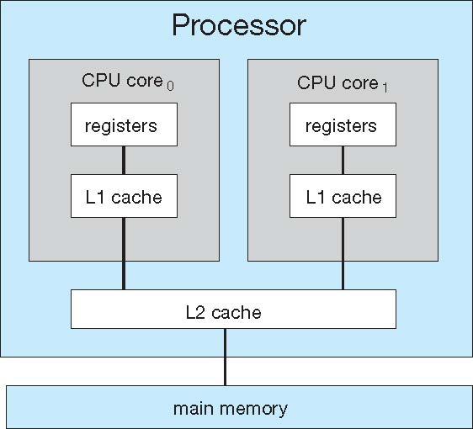
A dual-core with two cores placed on the same chip

Slide 31
Clustered Systems
Like multiprocessor systems, but multiple systems working together
Usually sharing storage via a storage-area network (SAN)
Provides a high-availability service which survives failures
  Asymmetric clustering has one machine in hot-standby mode
  Symmetric clustering has multiple nodes running applications, monitoring each other
Some clusters are for high-performance computing (HPC)
  Applications must be written to use parallelization
Some have distributed lock manager (DLM) to avoid conflicting operations

Slide 32
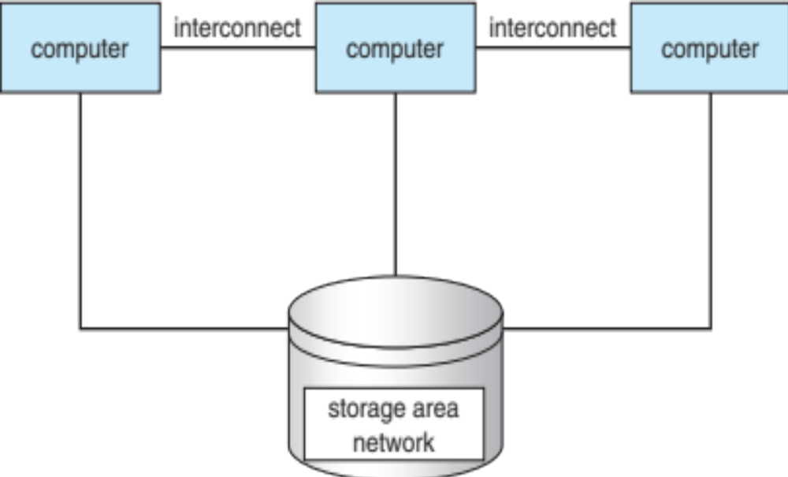
Clustered Systems

Slide 33
Multiprogrammed System
Single user cannot keep CPU and I/O devices busy at all times
Multiprogramming organizes jobs (code and data) so CPU always has one to execute
A subset of total jobs in system is kept in memory
Batch systems:
  One job selected and run via job scheduling
  When it has to wait (for I/O for example), OS switches to another job
Interactive systems:
  Logical extension of batch systems -- CPU switches jobs so frequently that users can interact with each job while it is running, creating interactive computing

Slide 34
Objectives: Multiprogramming system is inherently a multi-user system
Goal of multi programming: Maximum utilisation of CPU time
Efficient management of main memory
To achieve the above objectives, we need to answer the following questions:
  Which program should be brought into main memory?
  Of the resident programs, which one should be executed next?
The ability of an operating system to accept more than one job from a single user is called multitasking.
CSEN3103-BTech-Sec A

Slide 35
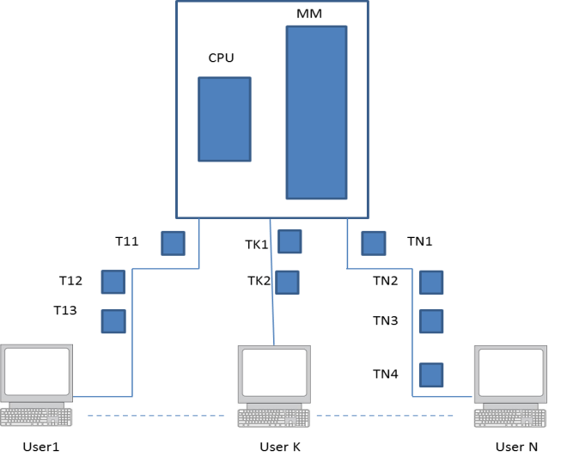
Multitasking System
Task: The user or system job that needs to be performed.
The ability of an operating system to accept more than one job from a single user is called multitasking.
Example: UNIX is a multi-user, multiprogramming and multitasking operating system.
CSEN3103-BTech-Sec A

Slide 36
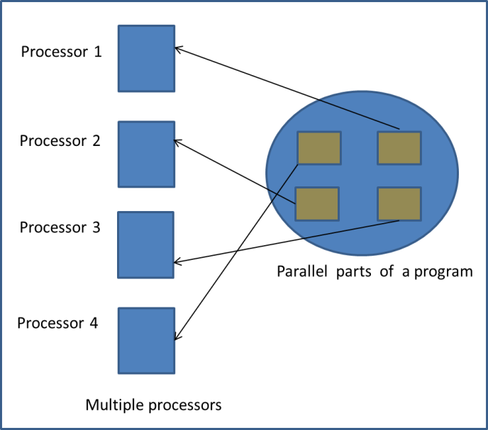
Parallel Processing
There are some algorithms which are inherently parallel in nature. Example, we have quick sort and merge sort dividing the data into partitions that can be processed independently of each other, provided a sufficiently number of processors are available in the computer system.
CSEN3103-BTech-Sec A

Slide 37
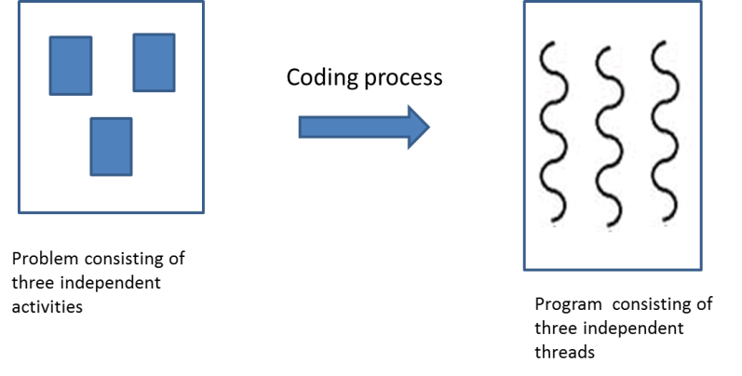
Multithreading operating system
A thread can be precisely defined as a separate path of execution through the code of a program. The operating system that can handle multiple threads of a program is called a multithreading operating system.
CSEN3103-BTech-Sec A

Slide 38
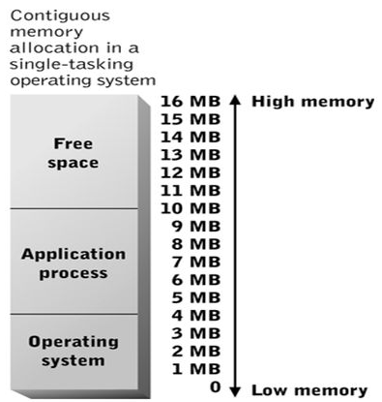
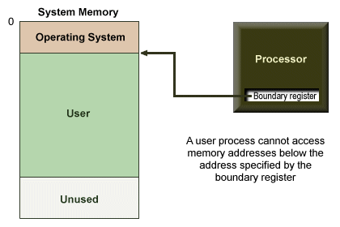
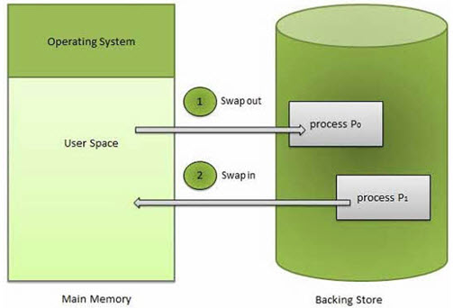
OS - MEMORY MANAGEMENT
CSEN3103-BTech-Sec A

Slide 39
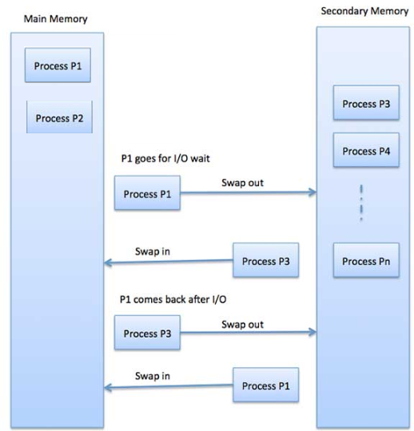
OS - MEMORY MANAGEMENT…
CSEN3103-BTech-Sec A

Slide 40


Slide 41
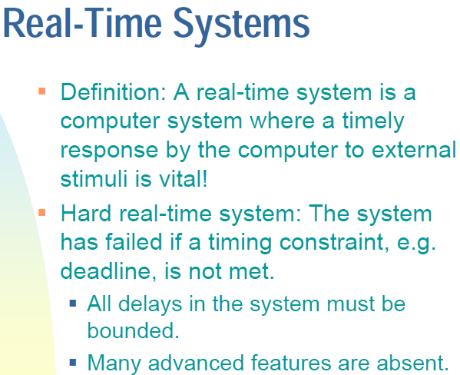

Slide 42
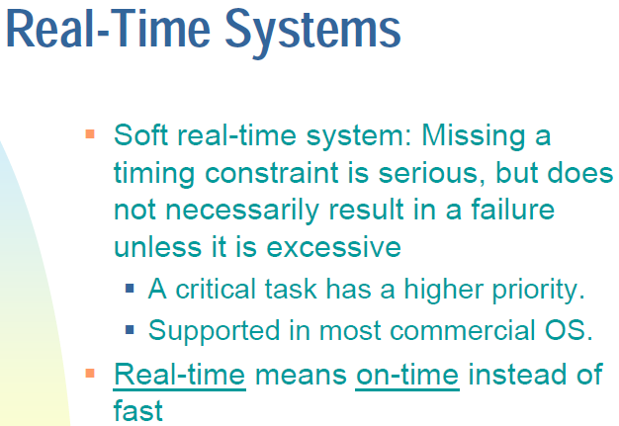

Slide 43
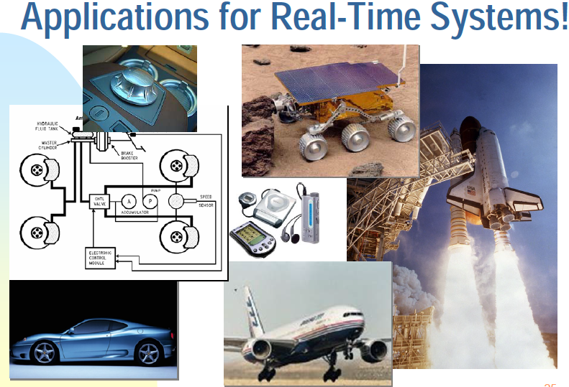

Slide 44
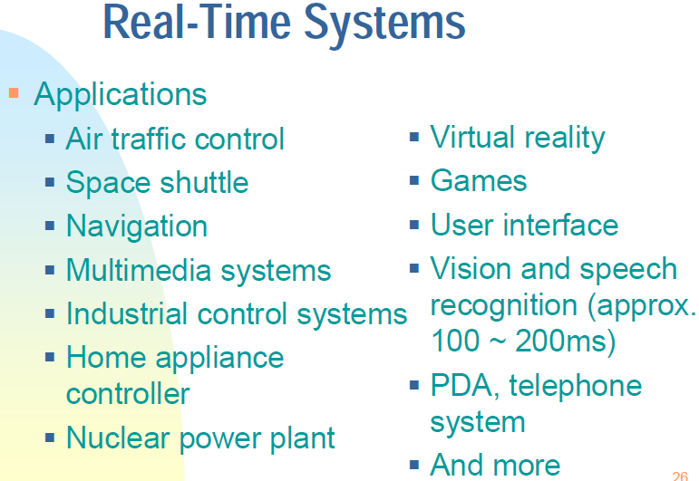

Slide 45
Open-Source Operating Systems
Operating systems made available in source-code format rather than just binary closed-source
Counter to the copy protection and Digital Rights Management (DRM) movement
Started by Free Software Foundation (FSF), which has “copyleft” GNU Public License (GPL)
Examples include GNU/Linux and BSD UNIX (including core of Mac OS X), and many more
Can use VMM like VMware Player (Free on Windows), Virtualbox (open source and free on many platforms - http://www.virtualbox.com)
  Use to run guest operating systems for exploration

Slide 46

Functions of Operating Systems ➔ what’s coming up……
Process management (processes, threads, cpu scheduling, process synchronization, mutual exclusion, deadlock, semaphores, monitors…..)
Memory management (MM + VM)
Processor management (keywords given… concurrency control….)
Input/Output and file/disk management
Security
Operating Systems

Slide 47
Computing Environments - Traditional
Stand-alone general purpose machines
But blurred as most systems interconnect with others (i.e., the Internet)
Portals provide web access to internal systems
Network computers (thin clients) are like Web terminals
Mobile computers interconnect via wireless networks
Networking becoming ubiquitous – even home systems use firewalls to protect home computers from Internet attacks

Slide 48
Computing Environments - Mobile
Handheld smartphones, tablets, etc
What is the functional difference between them and a “traditional” laptop?
Extra features – more OS features (GPS -- Waze)
Allows new types of apps like augmented reality
Use IEEE 802.11 wireless, or cellular data networks for connectivity
Leaders are Apple iOS and Google Android

Slide 49
Computing Environments – Distributed
Collection of separate, possibly heterogeneous, systems networked together
  Network is a communications path, TCP/IP most common
    Local Area Network (LAN)
    Wide Area Network (WAN)
    Metropolitan Area Network (MAN)
    Personal Area Network (PAN)
Network Operating System provides features to allow sharing of data between systems across a network.
  Communication scheme allows systems to exchange messages
  Illusion of a single system

Slide 50
Computing Environments – Client-Server
Dumb terminals supplanted by smart PCs
Many systems now servers, responding to requests generated by clients
  Compute-server system provides an interface to client to request services (i.e., database)
  File-server system provides interface for clients to store and retrieve files

Slide 51

Computing Environments - Peer-to-Peer
Another model of distributed system. P2P does not distinguish clients and servers
  Instead all nodes are considered peers
  Each node may act as client, server, or both
  Node must join P2P network
    Registers its service with central lookup service on network, or
    Broadcast request for service and respond to requests for service via discovery protocol
  Examples include Napster and Gnutella, Voice over IP (VoIP) such as Skype

Slide 52
Computing Environments – Cloud Computing
Delivers computing, storage, even apps as a service across a network
Logical extension of virtualization because it uses virtualization as the base for it functionality.
  Amazon EC2 has thousands of servers, millions of virtual machines, petabytes of storage available across the Internet, pay based on usage
Many types
  Public cloud – available via Internet to anyone willing to pay
  Private cloud – run by a company for the company’s own use
  Hybrid cloud – includes both public and private cloud components
  Software as a Service (SaaS) – one or more applications available via the Internet (i.e., word processor)
  Platform as a Service (PaaS) – software stack ready for application use via the Internet (i.e., a database server)
  Infrastructure as a Service (IaaS) – servers or storage available over Internet (i.e., storage available for backup use)

Slide 53

Computing Environments – Cloud Computing
Cloud computing environments composed of traditional OSes, plus VMMs, plus cloud management tools
  Internet connectivity requires security like firewalls
  Load balancers spread traffic across multiple applications

